Slide 1
COSC 4406
Software Engineering
Haibin Zhu, Ph.D.
Dept. of Computer Science and mathematics, Nipissing University, 100 College Dr., North Bay, ON P1B 8L7, Canada, haibinz@nipissingu.ca, http://www.nipissingu.ca/faculty/haibinz

Slide 2
Lecture 13
Web Engineering
Ref. Chap 16 & 17

Slide 3
Web Applications
WebApps encompass:
  complete Web sites
    Simple information Web sites
    Complex e-Commerce of other sites with embedded functionality and data retrieval
    Complex Web sites that are interoperable with other legacy software and systems
  specialized functionality within Web sites
  information processing applications that reside on the Internet or on an intranet or ExtraNet.

Slide 4
WebApp Attributes—I
Network intensiveness. A WebApp resides on a network and must serve the needs of a diverse community of clients.
Concurrency. A large number of users may access the WebApp at one time; patterns of usage among end-users will vary greatly.
Unpredictable load. The number of users of the WebApp may vary by orders of magnitude from day to day.
Performance. If a WebApp user must wait too long (for access, for server-side processing, for client-side formatting and display), he or she may decide to go elsewhere.

Slide 5
WebApp Attributes—II
Availability. Although expectation of 100 percent availability is unreasonable, users of popular WebApps often demand access on a “24/7/365” basis.
Data driven. The primary function of many WebApps is to use hypermedia to present text, graphics, audio, and video content to the end-user.
Content sensitive. The quality and aesthetic nature of content remains an important determinant of the quality of a WebApp.
Continuous evolution. Unlike conventional application software that evolves over a series of planned, chronologically-spaced releases, Web applications evolve continuously.

Slide 6
WebApp Attributes—III
Immediacy. WebApps often exhibit a time to market that can be a matter of a few days or weeks.
  With modern tools, sophisticated Web pages can be produced in only a few hours.
Security. In order to protect sensitive content and provide secure modes of data transmission, strong security measures must be implemented throughout the infrastructure that supports a WebApp and within the application itself.
Aesthetics. When an application has been designed to market or sell products or ideas, aesthetics may have as much to do with success as technical design.

Slide 7
WebApp Categories
informational—read-only content is provided with simple navigation and links
download—a user downloads information from the appropriate server
customizable—the user customizes content to specific needs
interaction—communication among a community of users occurs via chatroom, bulletin boards, or instant messaging
user input—forms-based input is the primary mechanism for communicating need
transaction-oriented—the user makes a request (e.g., places an order) that is fulfilled by the WebApp
service-oriented—the application provides a service to the user, e.g., assists the user in determining a mortgage payment
Portal—the application channels the user to other Web content or services outside the domain of the portal application
database access—the user queries a large database and extracts information
data warehousing—the user queries a collection of large databases and extracts information

Slide 8
Web Engineering
“Web development is an adolescent … Like most adolescents, it wants to be accepted as an adult as it tries to pull away from its parents. If it is going to reach its full potential, it must take a few lessons from the more seasoned world of software development.”
Doug Wallace et al

Slide 9
The WebE Process
Must accommodate:
  Incremental delivery
  Frequent changes
  Short timeline
Therefore,
  An incremental process model (Chapters 3 and 4) should be used in virtually all situations
  An agile process model (Chapter) is appropriate in many situations

Slide 10
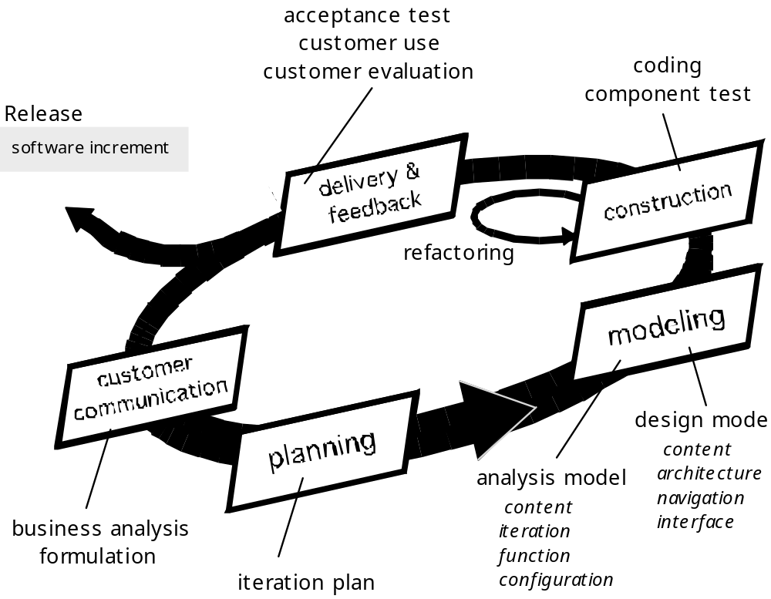
The WebE Process

Slide 11
The WebE Process Framework—I
Customer communication
  Business analysis defines the business/organizational context for the WebApp.
  Formulation is a requirements gathering activity involving all stakeholders. The intent is to describe the problem that the WebApp is to solve
Planning
  The “plan” consists of a task definition and a timeline schedule for the time period (usually measured in weeks) projected for the development of the WebApp increment.

Slide 12
The WebE Process Framework—II
Modeling
  Analysis model—establishes a basis for design
    Content Analysis.
    Interaction Analysis.
    Functional Analysis.
    Configuration Analysis.
  Design model—represents key WebApp elements
    Content design
    Aesthetic design
    Architectural design
    Interface design
    Navigation design
    Component design

Slide 13
The WebE Process Framework—III
Construction
  WebE tools and technology are applied to construct the WebApp that has been modeled
  Testing of all design elements
Delivery and Evaluation (Deployment)
  configure for its operational environment
  deliver to end-users, and
  Evaluation feedback is presented to the WebE team
  the increment is modified as required (the beginning of the next incremental cycle)

Slide 14
WebE—Basic Questions
How important is a Web site home page?
What is the most effective page layout (e.g., menu on top, on the right or left?) and does it vary depending upon the type of WebApp being developed?
Which media options have the most impact?
How much work can we expect a user to do when he or she is looking for information?
How important are navigational aids when WebApps are complex?
How complex can forms input be before it becomes irritating for the user? How can forms input be expedited?
How important are search capabilities?
Will the WebApp be designed in a manner that makes it accessible to those who have physical or other disabilities?
Susan Weinshenk

Slide 15
Formulation
begins with the identification of business need
moves into a description of WebApp objectives
defines major features and functions
establishes a requirements gathering activity that will lead to the development of an analysis model
allows stakeholders and the web engineering team to establish a common set of goals and objectives for the construction of the WebApp.
  identifies the scope of the development effort
  provides a means for determining a successful, outcome..

Slide 16
Formulation Questions
What is the main motivation (business need) for the WebApp?
What are the objectives that the WebApp must fulfill?
Who will use the WebApp?
Answers provide …
Informational goals—indicate an intention to provide specific content and/or information for the end-user
Applicative goals—indicate the ability to perform some task within the WebApp

Slide 17
WebE Requirements Gathering
Ask stakeholders to define user categories and develop descriptions for each category
Communicate with stakeholders to define basic WebApp requirements
Analyze information gathered and use information to follow-up with stakeholders
Define use-cases (Chapter 8) that describe interaction scenarios for each user class

Slide 18
Defining User Categories
What is the user’s overall objective when using the WebApp?
What is the user’s background and sophistication relative to the content and functionality of the WebApp?
How will the use arrive at the WebApp?
What generic WebApp characteristics does the user like/dislike?

Slide 19
Communicating with Stakeholders
Traditional focus groups—a trained moderator meets with a small group of representative end-users (or internal stakeholders playing the role of end-users).
Electronic focus groups—a moderated electronic discussion conducted with a group of representative end-users and stakeholders.
Iterative surveys—a series of brief surveys, addressed to representative users and requesting answers to specific questions about the WebApp
Exploratory surveys—a Web-based survey that is tied to one or more WebApps that have users who are similar to the ones that will use the WebApp to be developed.
Scenario-building—selected user are asked to create informal use-cases that describe specific interactions with the WebApp.

Slide 20
Preliminary Analysis
Categorize information gathered by user class and transaction type
Develop lists of …
  content objects
  operations that are applied to content objects within a specific user transaction
  functions (e.g., informational, computational, logical, and help-oriented) that the WebApp provides for end-users
  other non-functional requirements that are noted during the communication activities.

Slide 21
Use-Cases
Provide the detail necessary to create an effective analysis model
Help the developer to understand how users perceive their interaction with the WebApp
Use-cases help to compartmentalize Web engineering work
Use-cases provide important guidance for those who must test the WebApp

Slide 22
The WebE Team
WebE team roles
  Content Developer/Providers
  Web Publisher
  Web Engineer.
  Business domain experts
  Support Specialist
  Administrator (a.k.a. “Web Master”)

Slide 23
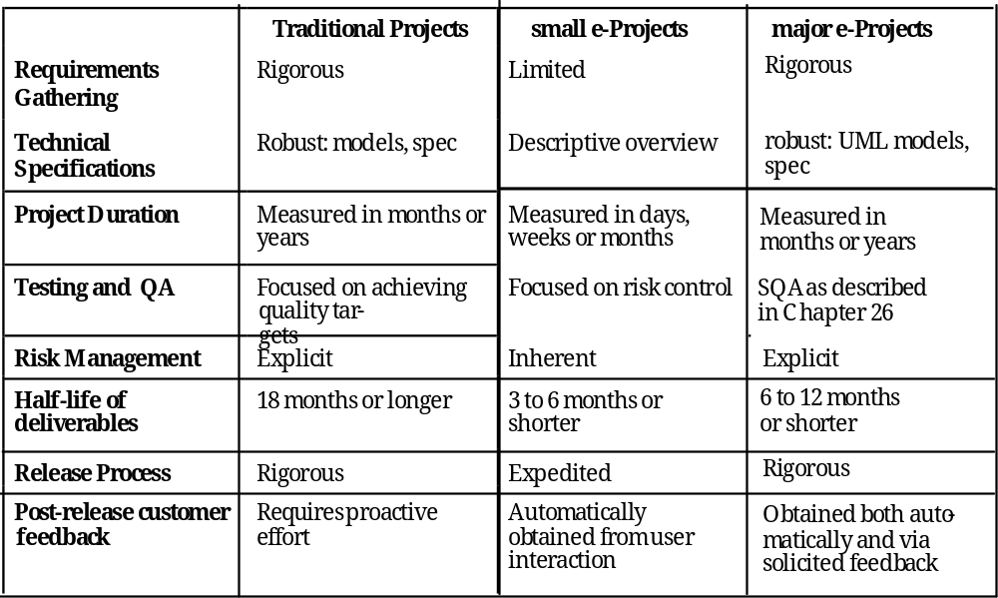
Project Differences

Slide 24
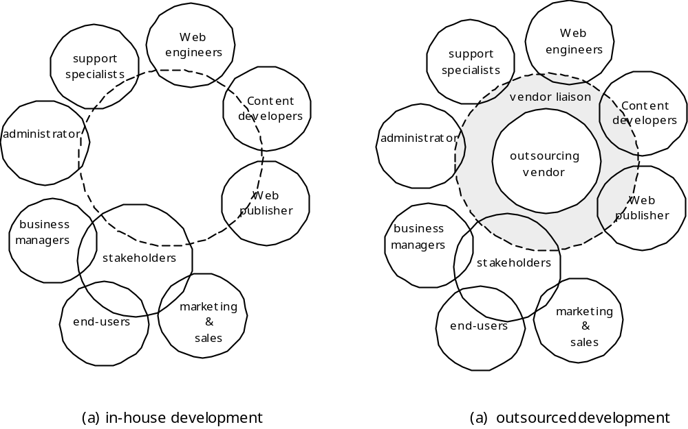
Outsourcing vs. In-house

Slide 25
WebApp Outsourcing - I
Initiate the project by performing the following tasks internally
  Gather requirements
  Develop a “rough design”
  Develop a rough schedule with delivery dates
    Consider increments
  Make a list of responsibilities
    For in-house staff
    For outsourcing vendor
  Define liaison mechanisms

Slide 26
WebApp Outsourcing - II
Select Candidate Outsourcing Vendors
Assess the Validity of Price Quotes and the Reliability of Estimates
  Does the quoted cost of the WebApp provide a direct or indirect return-on-investment that justifies the project?
  Does the vendor that has provided the quote exhibit the professionalism and experience we require?
Understand the Degree of Project Management You Can Expect/Perform
Assess the Development Schedule
Manage Scope

Slide 27
WebApp Planning - In-House
Understand scope, the dimensions of change, and project constraints
Define an incremental project strategy
Perform risk analysis
Develop a quick estimate
Select a task set (process description)
Establish a schedule
Define project tracking mechanisms
Establish a change management approach

Slide 28
WebE—Best Practices
Take the time to understand the business needs and product objectives, even if the details of the WebApp are vague.
Describe how users will interact with the WebApp using a scenario-based approach
Develop a project plan, even it its very brief.
Spend some time modeling what it is that you’re going to build.
Review the models for consistency and quality.
Use tools and technology that enable you to construct the system with as many reusable components as possible.
Don’t rely on early users to debug the WebApp—design comprehensive tests and execute them before releasing the system.

Slide 29
WebE “Worst Practices”
We have a great idea, so lets begin building the WebApp—now.
Stuff will change constantly, so there’s no point in trying to understand WebApp requirements.
Developers whose dominant experience has been in traditional software development can develop WebApps immediately. No new training is required.
Be bureaucratic.
Testing? Why bother?

Slide 30
Analysis
Content Analysis. The full spectrum of content to be provided by the WebApp is identified, including text, graphics and images, video, and audio data. Data modeling can be used to identify and describe each of the data objects.
Interaction Analysis. The manner in which the user interacts with the WebApp is described in detail. Use-cases can be developed to provide detailed descriptions of this interaction.
Functional Analysis. The usage scenarios (use-cases) created as part of interaction analysis define the operations that will be applied to WebApp content and imply other processing functions. All operations and functions are described in detail.
Configuration Analysis. The environment and infrastructure in which the WebApp resides are described in detail.

Slide 31
When Do We Perform Analysis?
In some WebE situations, analysis and design merge. However, an explicit analysis activity occurs when …
  the WebApp to be built is large and/or complex
  the number of stakeholders is large
  the number of Web engineers and other contributors is large
  the goals and objectives (determined during formulation) for the WebApp will effect the business’ bottom line
  the success of the WebApp will have a strong bearing on the success of the business

Slide 32
Design & WebApps
“There are essentially two basic approaches to design: the artistic ideal of expressing yourself and the engineering ideal of solving a problem for a customer.”
Jakob Nielsen
When should we emphasize WebApp design?
  when content and function are complex
  when the size of the WebApp encompasses hundreds of content objects, functions, and analysis classes
  when the success of the WebApp will have a direct impact on the success of the business

Slide 33
Design & WebApp Quality
Security
  Rebuff external attacks
  Exclude unauthorized access
  Ensure the privacy of users/customers
Availability
  the measure of the percentage of time that a WebApp is available for use
Scalability
  Can the WebApp and the systems with which it is interfaced handle significant variation in user or transaction volume
Time to Market

Slide 34
Summary
Attributes of Web-based systems
Web Engineering Process
Formulating Web-Based Systems
Web Engineering Team
Web Engineering Project Management
Web Engineering Practices
Web Engineering Analysis and Design

